Slide 1
Exception Handling in PL/SQL

Slide 2
Exception Handling in PL/SQL
An exception is an error which disrupts the normal flow of program instructions. PL/SQL provides us the exception block which raises the exception thus helping the programmer to find out the fault and resolve it.
There are two types of exceptions defined in PL/SQL
User defined exception.
System defined exceptions.
WHEN exception THEN statement;

Slide 3
DECLARE
declarations section;
BEGIN
executable command(s);
EXCEPTION
WHEN exception1 THEN
statement1;
WHEN exception2 THEN
statement2;
[WHEN others THEN]
/* default exception handling code */
END;

Slide 4
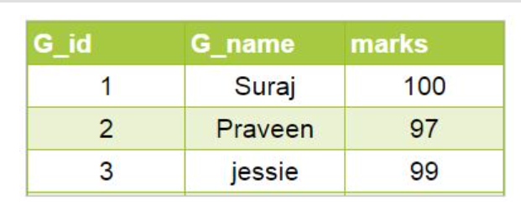
System-defined exceptions
System-defined exceptions are further divided into two categories:
Named system exceptions.
Unnamed system exceptions.
Named system exceptions: They have a predefined name by the system like ACCESS_INTO_NULL, DUP_VAL_ON_INDEX, LOGIN_DENIED etc.

Slide 5
NO_DATA_FOUND: It is raised WHEN a SELECT INTO statement returns no rows.
DECLARE
temp varchar(20);
BEGIN
SELECT g_id into temp from geeks where g_name='GeeksforGeeks';
exception
WHEN no_data_found THEN
dbms_output.put_line('ERROR');
dbms_output.put_line('there is no name as');
dbms_output.put_line('GeeksforGeeks in geeks table');
end;

Slide 6
TOO_MANY_ROWS:It is raised WHEN a SELECT INTO statement returns more than one row.
DECLARE
temp varchar(20);
BEGIN
-- raises an exception as SELECT
-- into trying to return too many rows
SELECT g_name into temp from geeks;
dbms_output.put_line(temp);
EXCEPTION
WHEN too_many_rows THEN
dbms_output.put_line('error trying to SELECT too many rows');
end;

Slide 7
VALUE_ERROR:This error is raised WHEN a statement is executed that resulted in an arithmetic, numeric, string, conversion, or constraint error. This error mainly results from programmer error or invalid data input.
DECLARE
temp number;
BEGIN
SELECT g_name into temp from geeks where g_name='Suraj';
dbms_output.put_line('the g_name is '||temp);
EXCEPTION
WHEN value_error THEN
dbms_output.put_line('Error');
dbms_output.put_line('Change data type of temp to varchar(20)');
END;

Slide 8
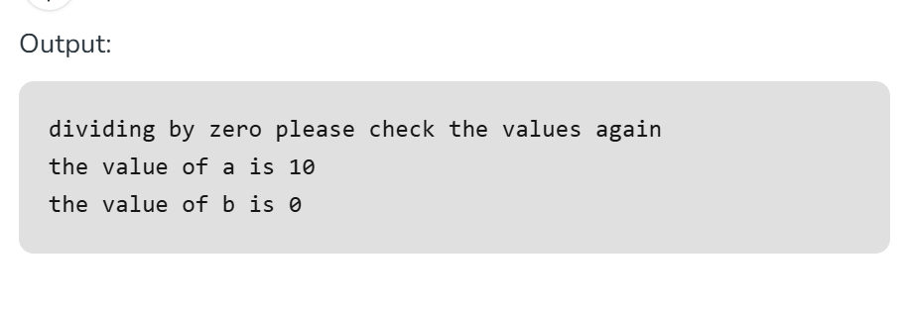
ZERO_DIVIDE = raises exception WHEN dividing with zero.
DECLARE
a int:=10;
b int:=0;
answer int;
BEGIN
answer:=a/b;
dbms_output.put_line('the result after division is'||answer);
exception
WHEN zero_divide THEN
dbms_output.put_line('dividing by zero please check the values again');
dbms_output.put_line('the value of a is '||a);
dbms_output.put_line('the value of b is '||b);
END;

Slide 9
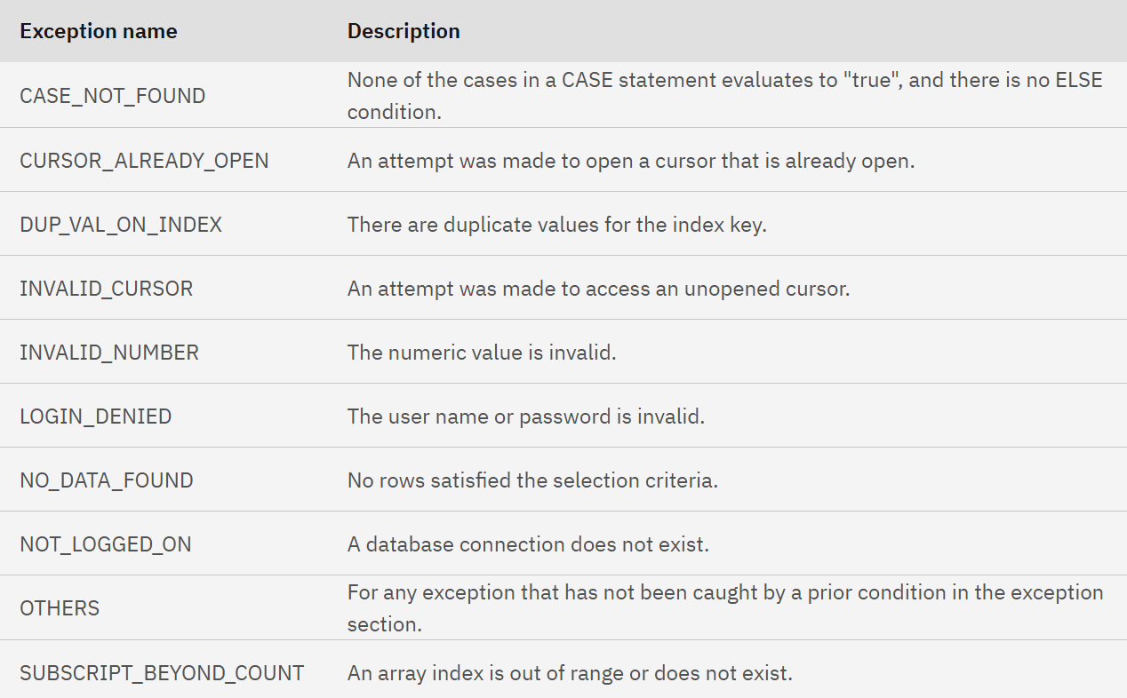

Slide 10
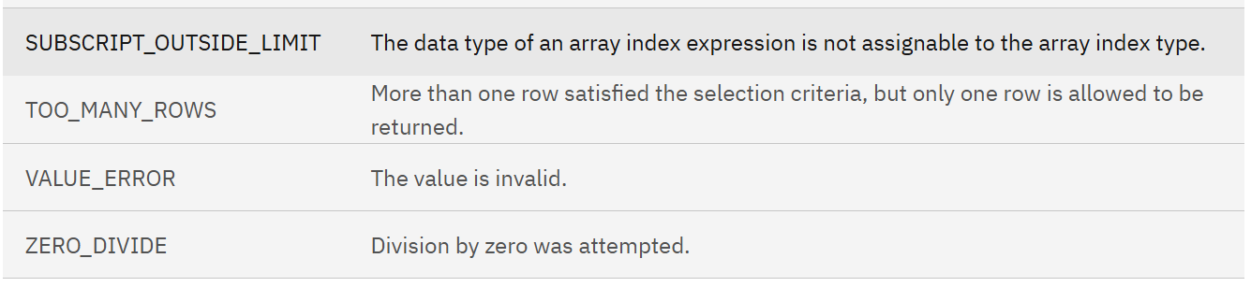
Cont..

Slide 11
User defined exceptions:
This type of users can create their own exceptions according to the need and to raise these exceptions explicitly raise command is used.
Example:
Divide non-negative integer x by y such that the result is greater than or equal to 1.From the given question we can conclude that there exist two exceptions
Division be zero.
If result is greater than or equal to 1 means y is less than or equal to x.

Slide 12
DECLARE
x int:=&x; /*taking value at run time*/
y int:=&y;
div_r float;
exp1 EXCEPTION;
exp2 EXCEPTION;
BEGIN
IF y=0 then
raise exp1;
ELSEIF y > x then
raise exp2;
ELSE
div_r:= x / y;
dbms_output.put_line('the result is '||div_r);
END IF;
EXCEPTION
WHEN exp1 THEN
dbms_output.put_line('Error');
dbms_output.put_line('division by zero not allowed');
WHEN exp2 THEN
dbms_output.put_line('Error');
dbms_output.put_line('y is greater than x please check the input');
END;

Slide 13
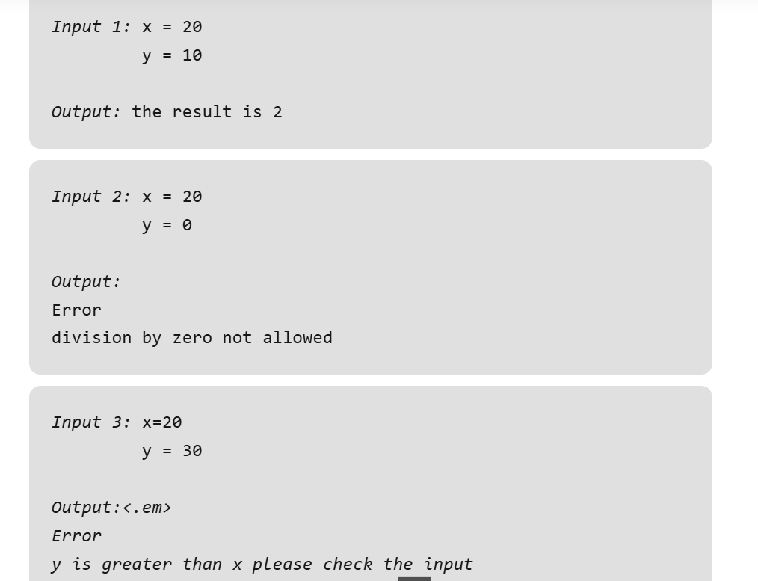

Slide 14
RAISE_APPLICATION_ERROR: It is used to display user-defined error messages with error number whose range is in between -20000 and -20999. When RAISE_APPLICATION_ERROR executes it returns error message and error code which looks same as Oracle built-in error.
DECLARE
myex EXCEPTION;
n NUMBER :=10;
BEGIN
FOR i IN 1..n LOOP
dbms_output.put_line(i*i);
IF i*i=36 THEN
RAISE myex;
END IF;
END LOOP;
EXCEPTION
WHEN myex THEN
RAISE_APPLICATION_ERROR(-20015, 'Welcome to GeeksForGeeks');
END;

Slide 15
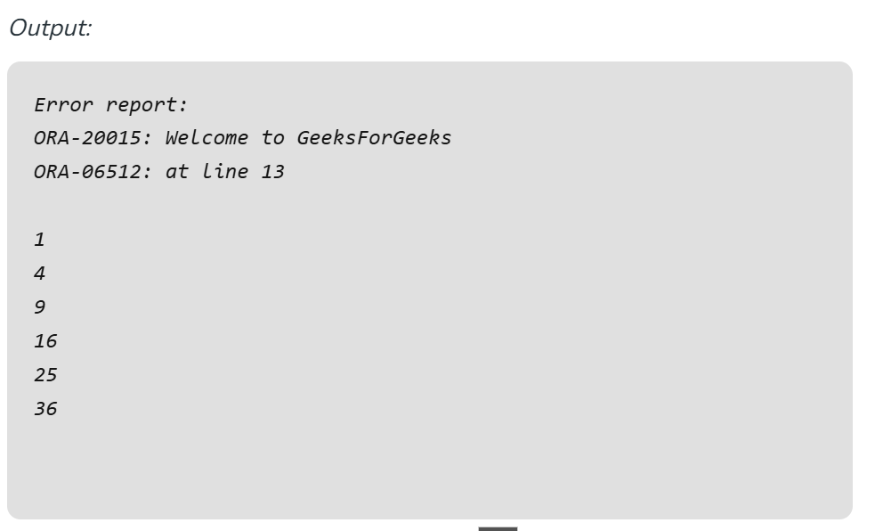

Slide 16
GOTO statement in PL/SQL

Slide 17
GOTO statement in PL/SQL
A GOTO statement in PL/SQL programming language provides an unconditional jump from the GOTO to a labeled statement in the same subprogram.
GOTO label;
..
..
<< label >>
statement;

Slide 18
DECLARE
a number(2) := 10;
BEGIN
<<loopstart>>
-- while loop execution
WHILE a < 20 LOOP
dbms_output.put_line ('value of a: ' || a);
a := a + 1;
IF a = 15 THEN
a := a + 1;
GOTO loopstart;
END IF;
END LOOP;
END;
/

Slide 19
Prime number
DECLARE
p VARCHAR2(30);
n PLS_INTEGER := 37;
BEGIN
FOR j in 2..ROUND(SQRT(n)) LOOP
IF n MOD j = 0 THEN
p := ' is not a prime number';
GOTO print_now;
END IF;
END LOOP;
p := ' is a prime number';
<<print_now>>
DBMS_OUTPUT.PUT_LINE(TO_CHAR(n) || p);
END;
/

